Slide 1
Analysis Of Flight Delay And Cancellation (2015)
Presented by:
J. Sri Lakshmi

Slide 2
TOOLS USED:
Data Cleaning : TALEND OPEN STUDIO
Creation Of Dimension And Fact table : TALEND OPEN STUDIO
Table Creation And Data Loading : CLOUDERA
Queries Using HIVE
Data Analysis Using DATABRICKS

Slide 3
FLOW CHART
Data Cleaning Process Using Talend
Creation Of Fact And Dimension Tables
Loading Data to Cloudera
Data Analysis Using Dataframes
Queries Using Hive

Slide 4
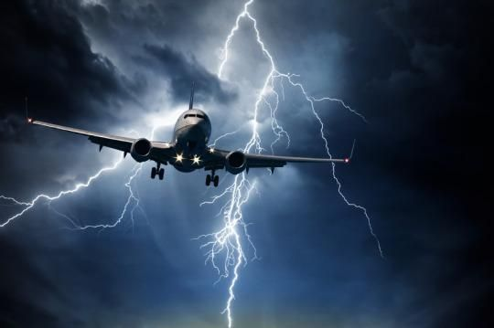
Problem Description
Analyzing the flight details of 2015 data to get insights of U.S flights.
Getting insights into flights route, there delays like arrival delay and departure delay and average delay of the various Airlines operating within the U.S.

Slide 5
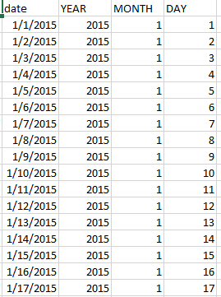
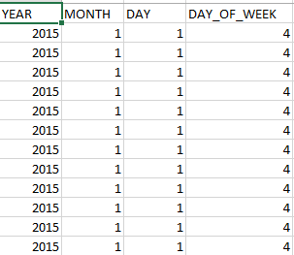
Data Cleaning
With around 10 lakh rows of data to be analyzed ,data cleaning becomes a necessity to accelerate the analysis process.
While most of the data present was clean and well structured, the date column was reorganized properly.
Tools used include Talend.

Slide 6
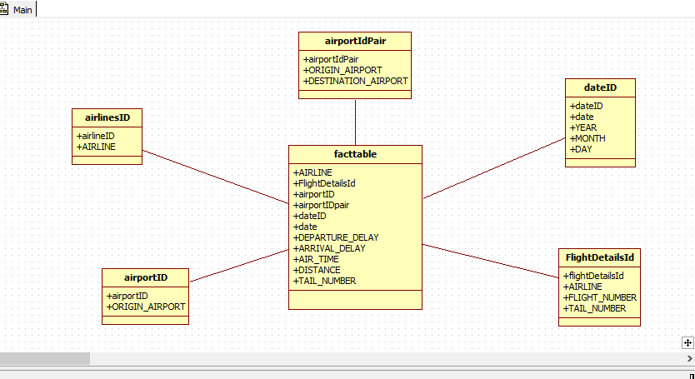
Fact And Dimension Table

Slide 7
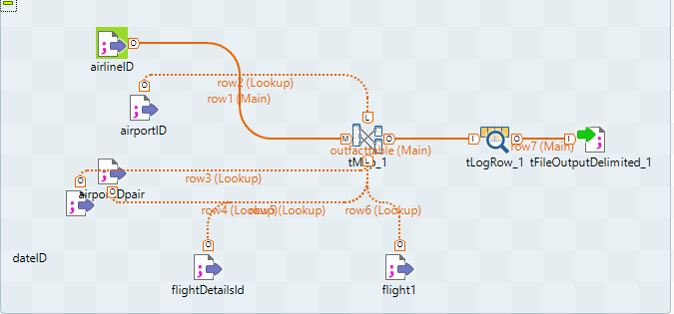
Fact Table Creation

Slide 8

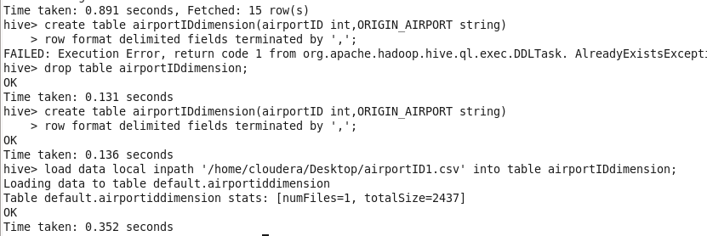
Creating And Loading Data into Dimension Tables

Slide 9
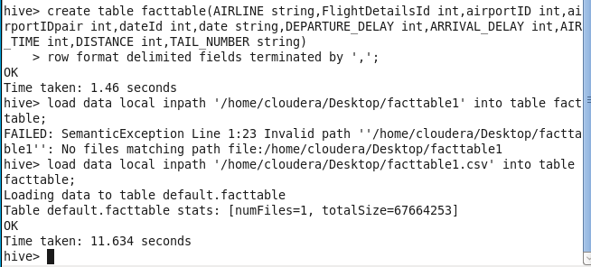
Creating Fact Table And Loading Data

Slide 10
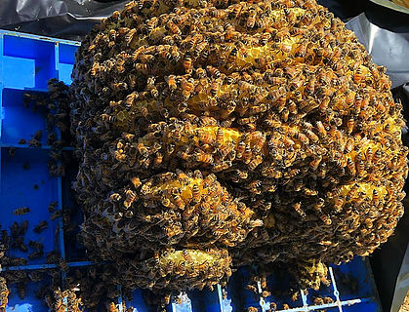


Analyzing the data
Hive and Talend was used in
analysing the data.
Hive uses HQL (Hive Query Language) to
retrieve data from large datasets.
Talend was also used in querying and gaining
insights into the data

Slide 11
Highest arrival delay
In the year 2015 American Airlines registered an arrival delay of about 2000 mins for the flight number 125 going from BHM to DFW. These are the max delay registered by each airline company during the same duration.

Slide 12
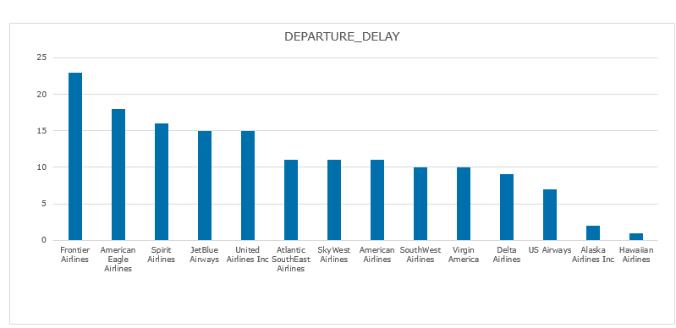

Average departure delay
In the year 2015 Frontier Airlines registered an average departure delay of about 23 mins, the maximum among all airlines while Hawaiian Airlines registered the lowest average departure delay for the same duration.

Slide 13
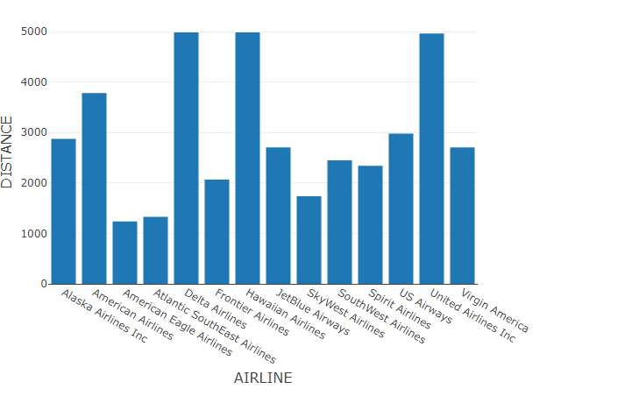

Longest routes
From this data we can infer that the first three airlines are only the ones providing airline services for long routes of over 4900 kms

Slide 14

Average arrival delay
In the year 2015 Frontier Airlines registered an average Arrival delay of about 23 mins, the maximum among all airlines while Alaska Airlines Inc registered the lowest average Arrival delay for the same duration.

Slide 15
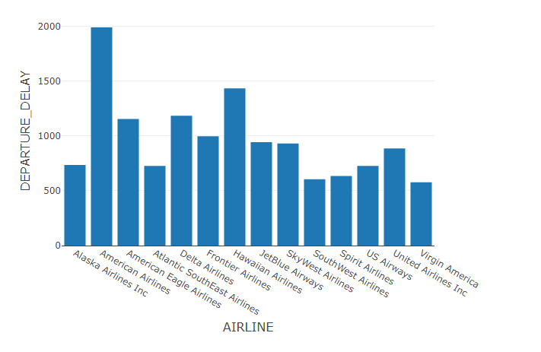
Highest departure delay
In the year 2015 American Airlines registered a departure delay of about 1971 mins. These are the max delay registered by each airline company during the same duration. Virgin Airlines here also registered the minimum departure delay.

Slide 16

Flight Count
Southwest airlines owned a majority of flights in the U.S having more than 2 lakh flights traversing between the cities of the U.S in the span of 3 months. While Virginia Airlines had the least number of operational flights.

Slide 17
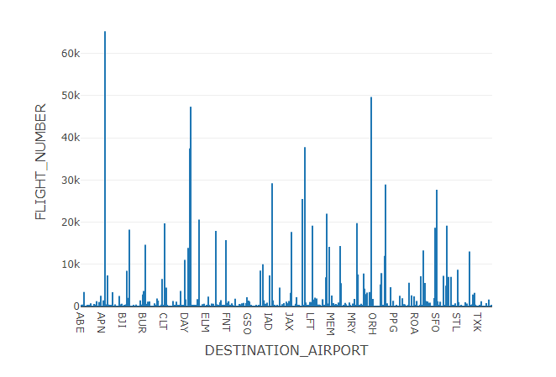
Busiest airport
The airport of ATL experienced the largest number of flights with the count being above 65000.While ITH just had 4 flights during the period.

Slide 18
Few analysis
Though flight count of SouthWest Airlines is the highest its average departure delay and average arrival delay is far less than its highest counterparts.
Making it more popular.
Frontier Airlines, Virgin America and SkyWest Airlines have focused on smaller routes.
Moreover because of operating on shorter routes Virgin America happens to be more punctual on its timing having the least arrival and departure delay

Slide 19
